Slide 1
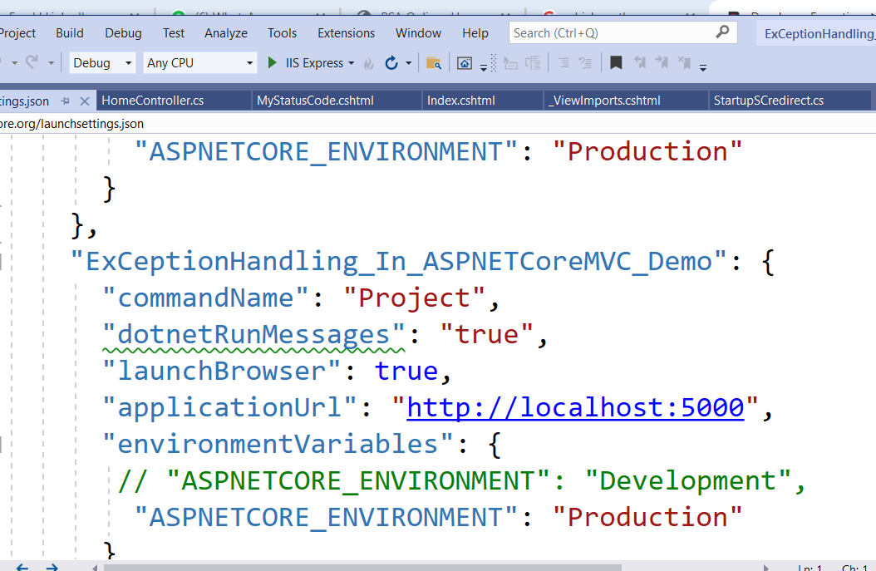
Developer Exception Page Middleware in ASP.NET Core

Slide 2
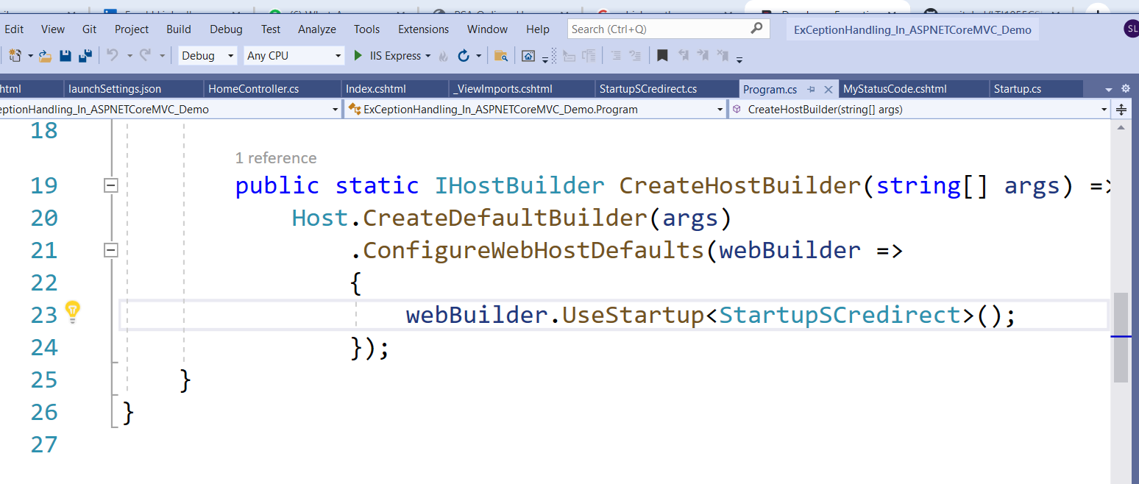

Slide 3
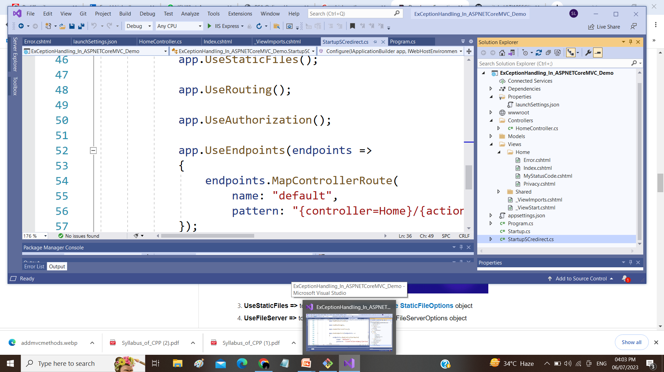

Slide 4
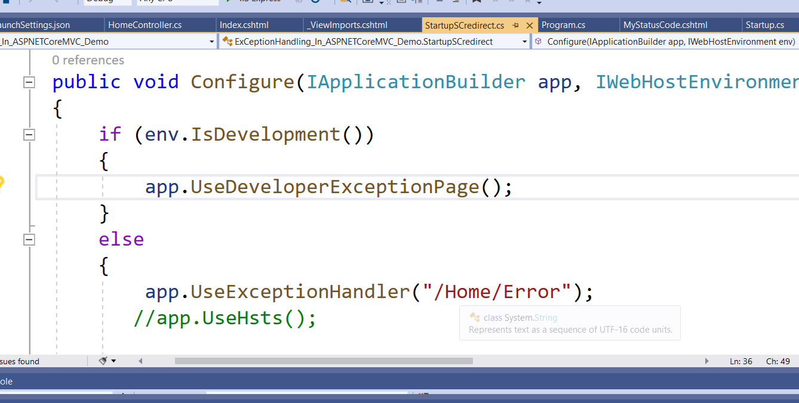

Slide 5
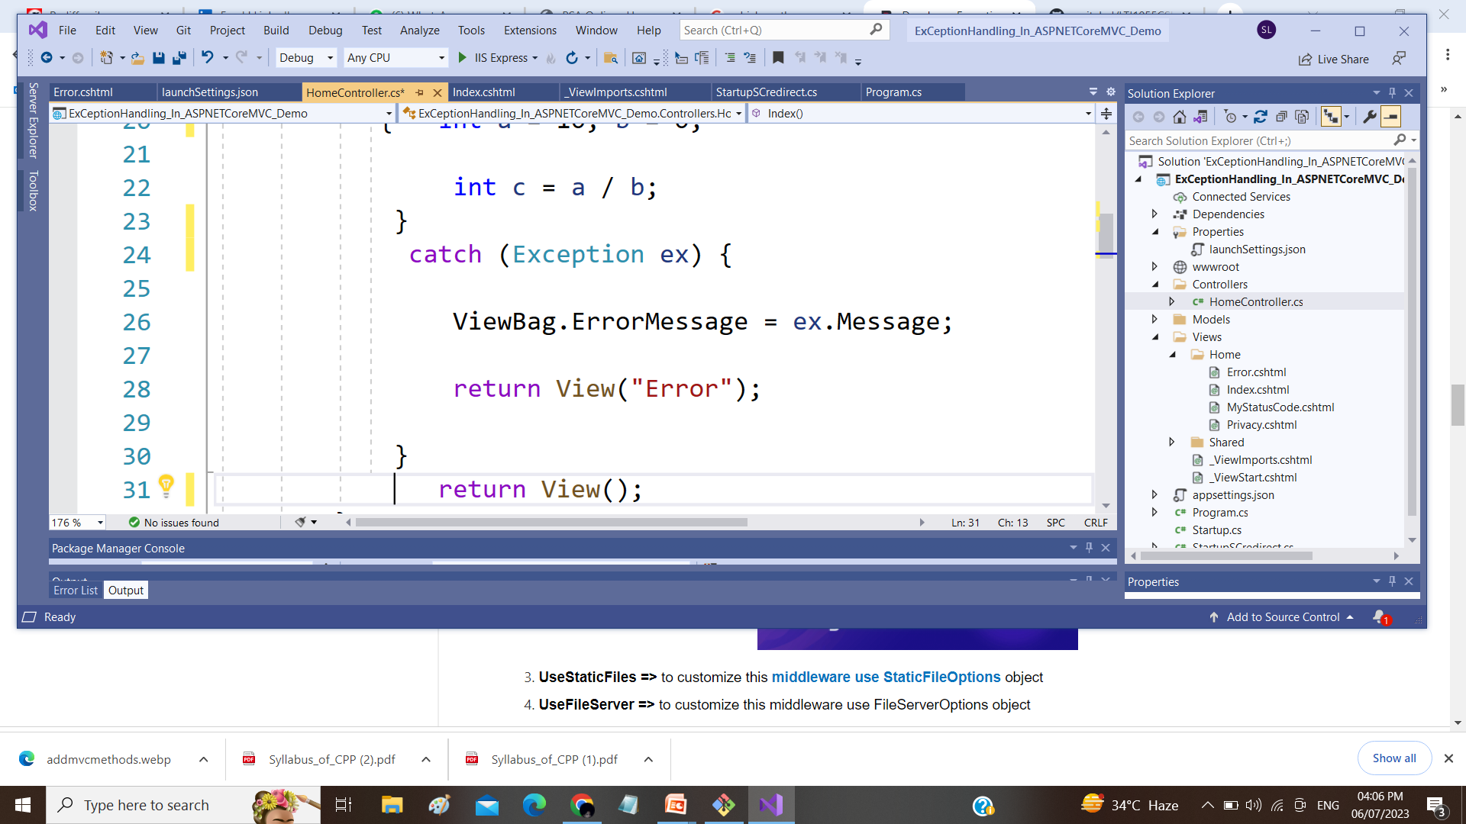

Slide 6
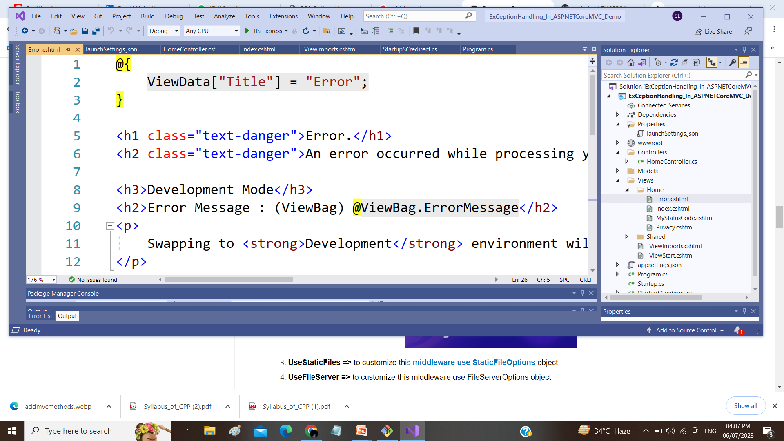

Slide 7
How to Customize the UseDeveloperExceptionPage Middleware in ASP.NET Core?
If you want then you can also customize the UseDeveloperExceptionPage middleware. The point that you need to remember is whenever you want to customize a middleware component in ASP.NET Core then you need to use the respective Options object. For example
UseDeveloperExceptionPage => to customize this middleware use DeveloperExceptionPageOptions object
UseDefaultFiles => to customize this middleware use DefaultFilesOptions object

